Slide 1

DriverPass System Analysis
Logan Boyd
Notes:
[No speaker notes required for this slide.]

Slide 2

System Requirements
Functional Requirements:
The system must allow users to register and log in securely.
The system must enable data retrieval and updates in real-time from the database.
Nonfunctional Requirements:
Users should have the ability to reset their password if needed
The system must ensure 99.9% uptime for accessibility.
Notes:
The system will allow users to register and log in securely by validating case-sensitive usernames and unique passwords. This ensures only authorized users can access the platform, addressing the security needs of DriverPass.Users will be able to take practice tests, with the system displaying their progress in real-time. This supports DriverPass’s goal of helping users prepare effectively for driving tests. Users will have the ability to reset their passwords if needed. This enhances usability and ensures users can regain access without external support.The system will maintain 99.9% uptime to ensure consistent availability. This reliability is critical for DriverPass to maintain customer satisfaction and trust.

Slide 3
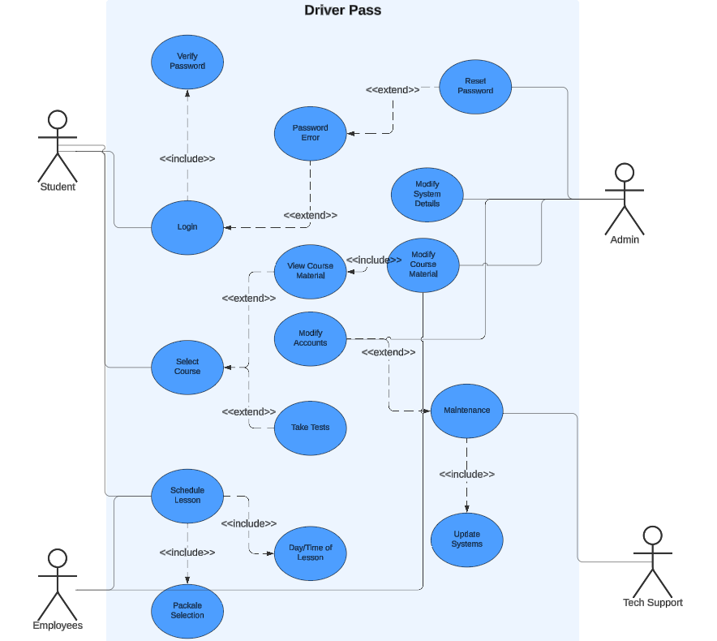
Use Case Diagram
[Insert your use case diagram here.]
Notes:
For DriverPass, different users interact with the system to perform various functions. The users such as students, employees, the admin, and tech support.
Students can register for courses, take practice tests, schedule driving lessons, modify or cancel reservations, and view their progress. Employees manage reservations, schedule appointments, and handle customer information. Admins have full access to the system to generate reports, manage user accounts, and oversee operations. Tech support maintains the system, resets passwords, and ensures security.
The design addresses DriverPass’s needs by ensuring that each user role has access to the necessary functions to perform their tasks efficiently. For instance, students can easily book and manage their driving lessons, while employees can assist them. Admins can track changes and generate activity reports to monitor the system's usage and performance. Additionally, the system can connect with the DMV to stay updated with the latest driving rules and policies, ensuring the training materials remain current.

Slide 4
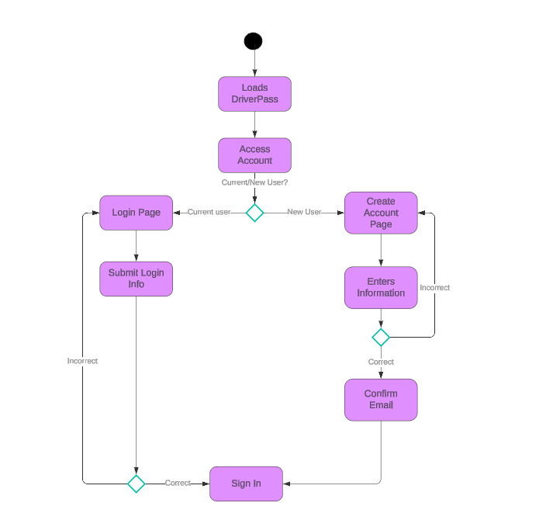
Activity Diagram
[Insert one of your activity diagrams here.]
Notes:
The diagram illustrates the process for accessing a DriverPass account, including both login and account creation. For current users, they simply log in with their credentials. For new users, they create an account and confirm their email before logging in. The design ensures easy navigation, handles errors efficiently, and adds an extra layer of security for new users.

Slide 5
Security
Each user will have a unique User ID and password
Database will be encrypted
Admins can delete or modify user settings if needed
Users will be locked out if too many failed attempts happen
Notes:
Security is a key focus in the system's design, extending beyond just usernames and passwords. Features like locking accounts after multiple failed login attempts will enhance security. This approach helps protect data integrity and ensures secure connections between users and the system. Users will also have the option to reset their own passwords, with IT support available to assist if needed.

Slide 6
System Limitations
Performance may differ in different parts of the world.
Reliant on Internet Connection
User Access Level is important
Notes:
One limitation of the design is that it relies heavily on internet connectivity. If there is no internet connection, users will not be able to update or modify their data, which could be inconvenient. Additionally, while the system allows for different user roles, it may be challenging to ensure that each user has the correct level of access and that unauthorized access is prevented.

